Slide 1




Arithmetic Sequences
Thus, an = a + (n - 1) d
an = 3 + (n - 1) 2 (using values of a and d)
Hence the value of 36th term is a36 = 3 + (36 - 1) 2
= 3 + 70
a36 = 73

Slide 2
Geometric Progression OR Sequence
A sequence in which every term after the first is obtained from the preceding term by multiplying it with a constant number is called a geometric sequence or geometric progression (G.P.)
The constant number, being the ratio of any two consecutive terms is called the common ratio of the
G.P. commonly denoted by “r”.
EXAMPLE:
1. 1, 2, 4, 8, 16, … (common ratio = 2)
2. 3, - 3/2, 3/4, - 3/8, … (common ratio = - 1/2)
3. 0.1, 0.01, 0.001, 0.0001, … (common ratio = 0.1 =
1/10)

Slide 3

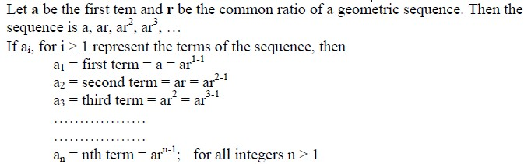
GENERAL TERM OF A GEOMETRIC SEQUENCE:

Slide 4

Geometric Progression
Examples:
1. Let a = 1 and r = −1. Then:
2. Let a = 2 and r = 5. Then:
3. Let a = 6 and r = 1/3. Then:

Slide 5
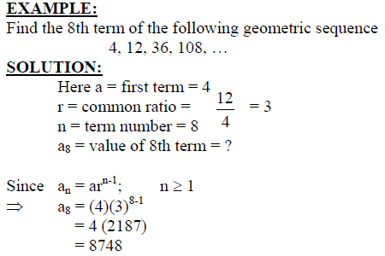
Geometric Sequence

Slide 6
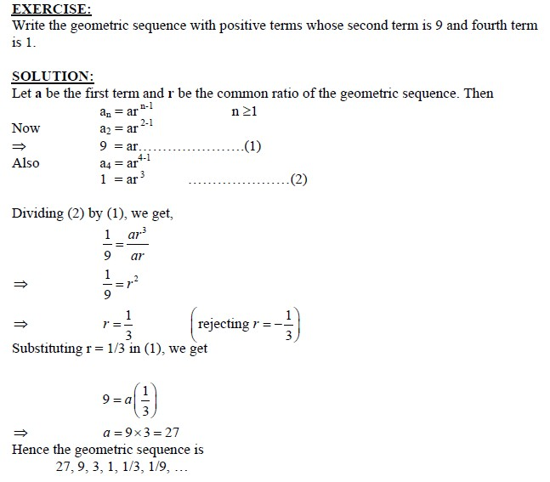
Geometric Sequence

Slide 7
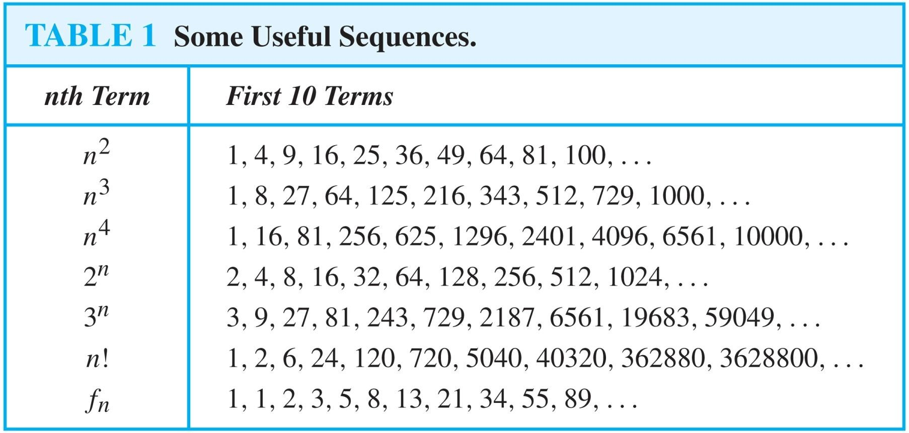
Useful Sequences

Slide 8
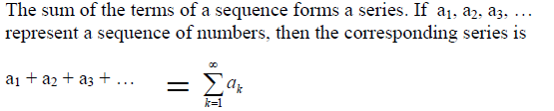
SERIES

Slide 9
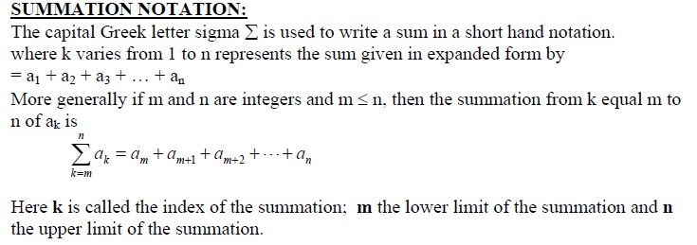
SUMMATIONS

Slide 10
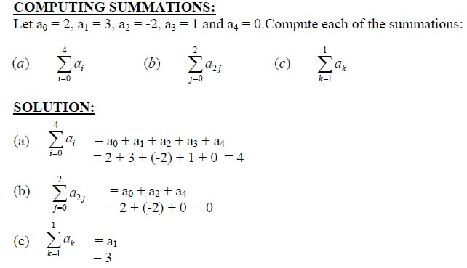
SUMMATIONS

Slide 11
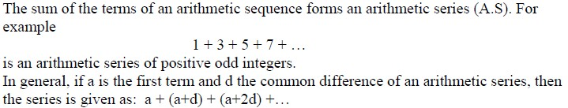
ARITHMETIC SERIES:

Slide 12
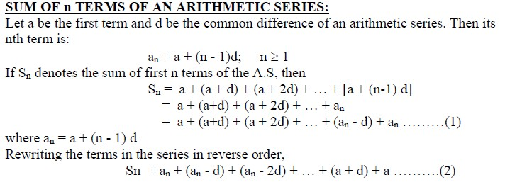
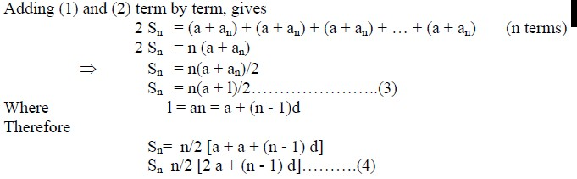

Slide 13
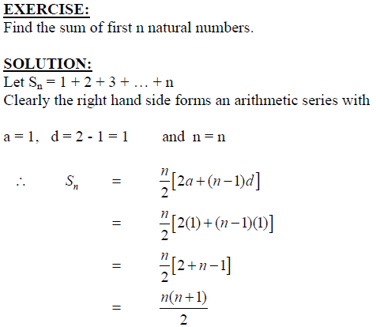
ARITHMETIC SERIES:

Slide 14
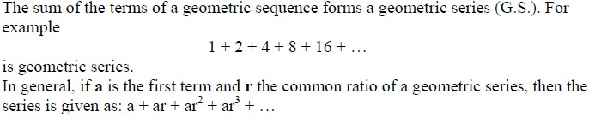
GEOMETRIC SERIES:

Slide 15
Strings
Definition: A string is a finite sequence of characters from a finite set (an alphabet).
Sequences of characters or bits are important in computer science.
The empty string is represented by λ.
The string abcde has length 5.

Slide 16
Recurrence Relations
Definition: A recurrence relation for the sequence {a_{n}} is an equation that expresses a_{n} in terms of one or more of the previous terms of the sequence, namely, a₀, a₁, …, a_{n-1}, for all integers n with n ≥ n₀, where n₀ is a nonnegative integer.
A sequence is called a solution of a recurrence relation if its terms satisfy the recurrence relation.
The initial conditions for a sequence specify the terms that precede the first term where the recurrence relation takes effect.

Slide 17
Questions about Recurrence Relations
Example 1: Let {a_{n}} be a sequence that satisfies the recurrence relation a_{n} = a_{n-1} + 3 for n = 1,2,3,4,…. and suppose that a₀ = 2. What are a₁ , a₂ and a₃?
[Here a₀ = 2 is the initial condition.]
Solution: We see from the recurrence relation that
a₁ = a₀ + 3 = 2 + 3 = 5
a₂ = 5 + 3 = 8
a₃ = 8 + 3 = 11

Slide 18
Questions about Recurrence Relations
Example 2: Let {a_{n}} be a sequence that satisfies the recurrence relation a_{n} = a_{n-1} – a_{n-2} for n = 2,3,4,…. and suppose that a₀ = 3 and a₁ = 5. What are a₂ and a₃?
[Here the initial conditions are a₀ = 3 and a₁ = 5. ]
Solution: We see from the recurrence relation that
a₂ = a₁ - a₀ = 5 – 3 = 2
a₃ = a₂ – a₁ = 2 – 5 = –3

Slide 19
Solving Recurrence Relations
Finding a formula for the nth term of the sequence generated by a recurrence relation is called solving the recurrence relation.
Such a formula is called a closed formula.
Various methods for solving recurrence relations will be covered in Chapter 8 where recurrence relations will be studied in greater depth.
Here we illustrate by example the method of iteration in which we need to guess the formula. The guess can be proved correct by the method of induction (Chapter 5).

Slide 20
Fibonacci Sequence
Definition: Define the Fibonacci sequence, f₀ ,f₁ ,f₂,…, by:
Initial Conditions: f₀ = 0, f₁ = 1
Recurrence Relation: f_{n}
^{= f}n-1 ^{+ f}n-2
Example: Find f₂ ,f₃ ,f₄ , f₅ and f₆ .
Answer:
f₂ = f₁ + f₀ = 1 + 0 = 1, f₃ = f₂ + f₁ = 1 + 1 = 2, f₄ = f₃ + f₂ = 2 + 1 = 3, f₅ = f₄ + f₃ = 3 + 2 = 5, f₆ = f₅ + f₄ = 5 + 3 = 8.

